Slide 1
8. The Application Layer

Slide 2
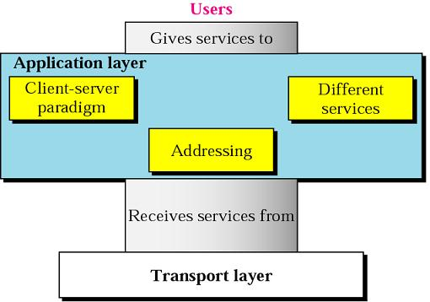
    the Application Layer:
      receives services from the transport layer and provides services to users (humans or software)
      provides user interfaces and support services such as email, remote file access and transfer, access to the WWW
    three general issues related to the application layer: the client-server paradigm, addressing, and services
1

Slide 3
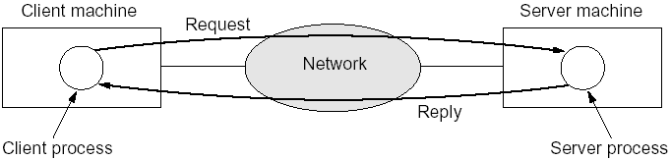
  8.1 The Client-Server Model
    to do a task, there must be a client and a server
    a computer runs a program to either request a service from another computer (client) or to provide a service to another computer (server)
    communication takes the form of the client process sending a message to the server process and then waiting for a reply
    a client program runs when needed, but the server program runs all the time
    Socket Interface: a set of system calls for communication between clients and servers

Slide 4
  8.2 Addressing
    a client and a server communicate with each other using addresses
    addressing mechanism in the application layer is different from the ones in other layers
      email address: abebe@aau.edu.et
      Web page (host name): http://www.cs.aau.edu.et
    these are aliases convenient for human beings; they must be mapped to IP addresses
    an application program needs the services of another program for this; this application program is called DNS - Domain Name System
    it uses port 53
    it is not directly used by the user; but by application programs to perform the mapping

Slide 5
    originally (when Internet was small), mapping was done using a host file with two columns stored on every host
      impossible nowadays
        the host file is too large
        updating all the host files in the world every time there is a change is difficult
    DNS
      a hierarchical, domain-based naming scheme and a distributed database system for implementing the naming scheme
      used for mapping host names and email addresses to IP addresses

Slide 6
    Name Space
      names assigned to machines must be carefully selected from a name space; names must be unique (as are addresses)
      a name space can be organized in two ways
      Flat Name Space
        a name is a sequence of characters without structure; like human names? may be
        difficult to be used in a large system since it must be centrally controlled to avoid duplication
      Hierarchical Name Space
        each name is made of several parts; the first may define the nature of the organization, the second the name, the third departments, ...
        the authority to assign and control the name spaces can be decentralized where a central authority assigns only the first two parts

Slide 7
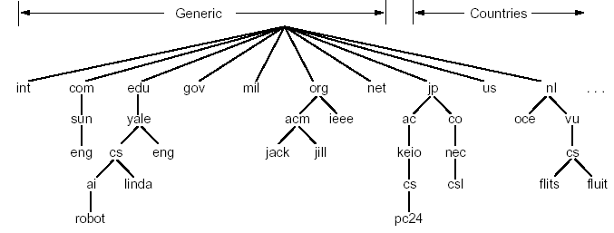
    The DNS Name Space
      hierarchical, defined in an inverted tree structure with the root at the top
      the tree can have only 128 levels
      Label
        each node has a label, a string with a maximum of 63 characters
        the root label is null
        children of a node must have different names (to guarantee uniqueness)

Slide 8
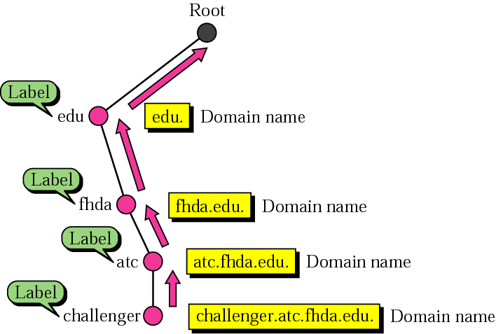
  Domain Name
    each node has a domain name
    a full domain name is a sequence of labels separated by dots (the last character is a dot; null string is nothing)
    case insensitive
    domain names are read from the node up to the root
    full path names must not exceed 255 characters

Slide 9
    Fully Qualified Domain Name (FQDN) or Absolute
      terminated by a null string
      contains the full name of a host, e.g., cs.aau.edu.et.
    Partially Qualified Domain Name (PQDN) or Relative
      not terminated with a null string
      it starts from a node but does not reach the root
      used when the name to be resolved belongs to the same site as the client (the resolver supplies the missing part, called the suffix to create an FQDN)

Slide 10
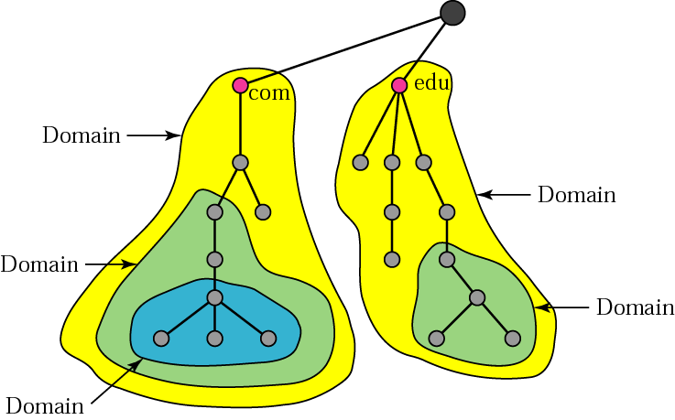
    Domain
      a domain is a subtree of the domain name space
      the name of the domain is the domain name of the node at the top of the subtree
      the Internet is divided into over 200 top-level domains; each partitioned into subdomains, ... ; the leaves represent domains that have no subdomains; a leaf domain may contain a single host or represent a company and contain thousands of hosts

Slide 11
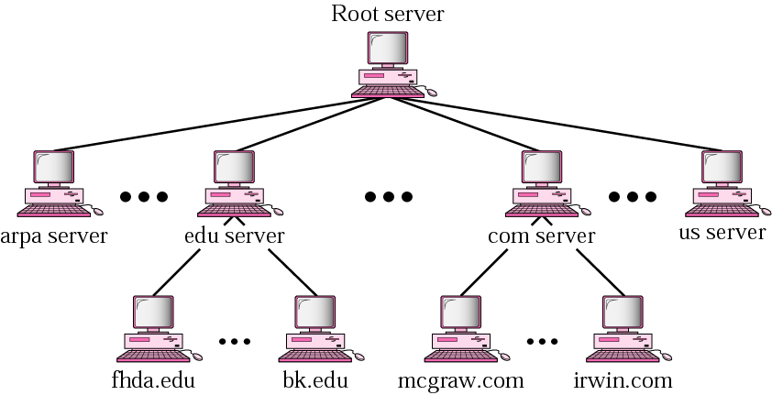
  Hierarchy of Name Servers
    storing the information contained in the domain name space in a single computer is inefficient and unreliable
    distribute the information among many computers called DNS servers
    there is a hierarchy of name servers as we have a hierarchy of names

Slide 12
    Zone
      what a server is responsible for, or has authority over, is called a zone; zones are nonoverlapping
      the server makes a database called a zone file and keeps all the information for every node under that domain
      it can divide its domain into subdomains and delegate part of its authority to other servers

Slide 13
    Root Server
      a server whose zone consists of the whole tree
      it usually does not store the whole information about domains but delegates its authority to other servers and keeps references to those servers
      there are currently more than 13 root servers , each covering the whole domain name space and distributed all around the world
    Primary and Secondary Servers
      a primary server is one that stores a file about the zone for which it is an authority; it is responsible for creating, maintaining, and updating the zone file
      a secondary server is one that transfers the complete information about a zone from another server (primary or secondary); it does not create or update the file
      such arrangement is to create a redundancy so that if one server fails, the other can still serve clients

Slide 14
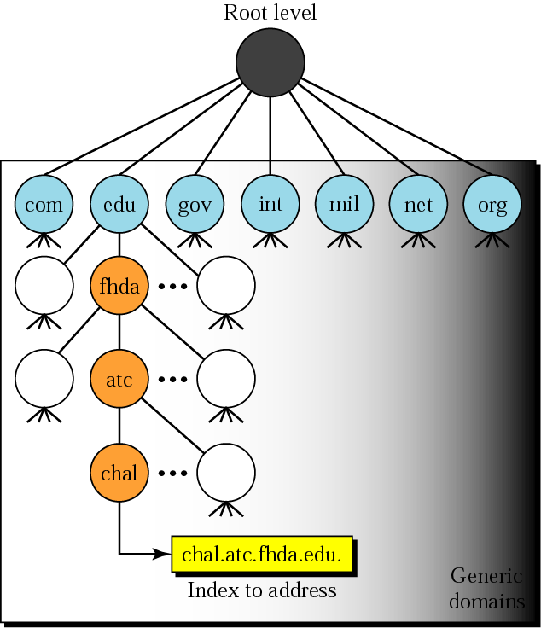
  Types of Top-Level Domains
    two types: generic domains and country domains; there is a third one called Inverse Domain (used to map an address to a name; we will not discuss it further)
    Generic Domains
      define registered hosts according to their generic behaviour
Label | Description
com | Commercial organizations
edu | Educational institutions
gov | Government institutions
int | International organizations
mil | Military groups
net | Network support centers
org | Nonprofit organizations

Slide 15
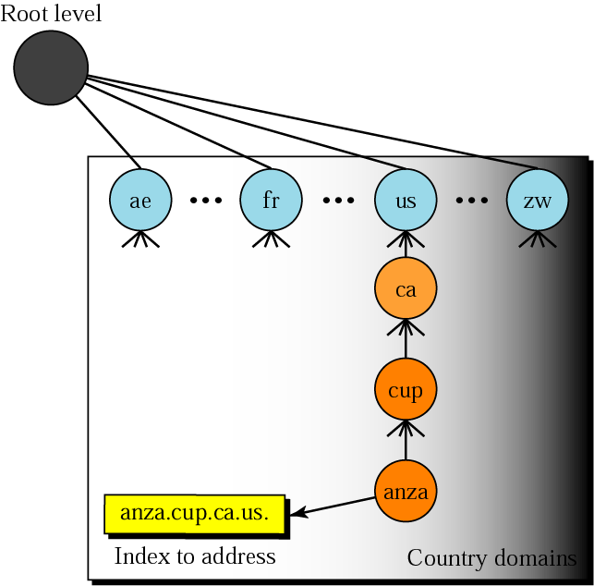
      newly introduced first-level domains
Label | Description
aero | Airlines and aerospace companies
biz | Businesses or firms (similar to com)
coop | Cooperative business organizations
info | Information service providers
museum | Museums and other nonprofit organizations
name | Personal names (individuals)
pro | Professional individual organizations
  Country Domains
    include one entry for every country (as defined by ISO) - two character abbreviations

Slide 16
  Resolution
    mapping a name to an address or an address to a name is called name-address resolution
    Resolver
      a host that needs to map an address to a name or a name to an address calls a DNS client named a resolver
      the resolver accesses the closest DNS server with a mapping request
      if the server has the information it satisfies the resolver; otherwise, it either refers the resolver to other servers (called Iterative Resolution) or asks other servers to provide the information (called Recursive Resolution)

Slide 17
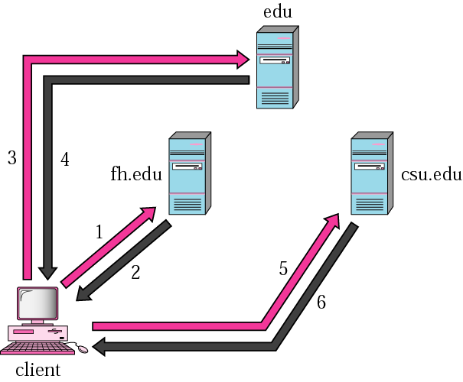
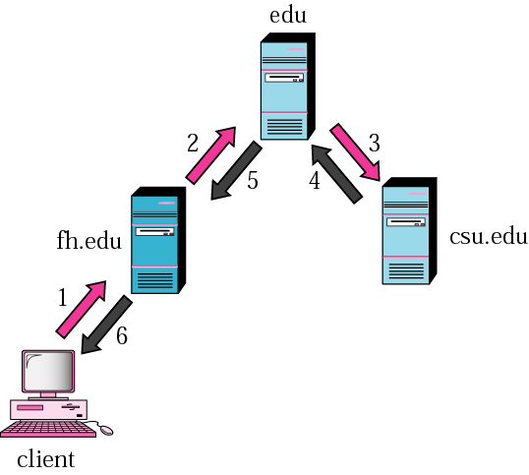
Iterative resolution
Recursive resolution

Slide 18
  8.3 Application Layer Services
    electronic mail (SMTP, MIME, POP3, IMAP, Webmail)
    file transfer (FTP - File Transfer Protocol)
    HTTP - Hypertext Transfer Protocol for accessing data on the WWW
    WWW
    Multimedia

Slide 19
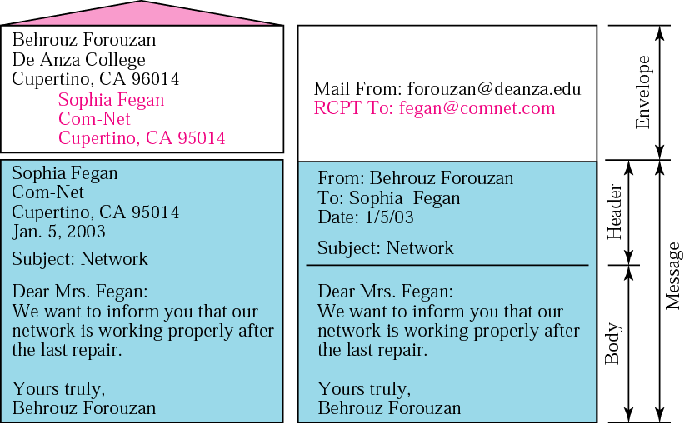
  1. Electronic Mail
    what is email? a message that includes text, voice, video, or graphics and sent to one or more recipients
    an email has an envelope and a message (similar to paper mail - snail mail)

Slide 20
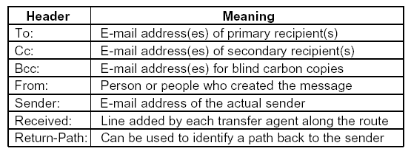
    the envelope contains the sender’s address, the receiver’s address, and other information such as priority; information used for routing or transporting the email
    the message part consists of a header (information for the system) and a body (the actual information for the human recipient); envelope fields and header fields confused in RFC 822 (Request for Comment)
RFC 822 header fields

Slide 21
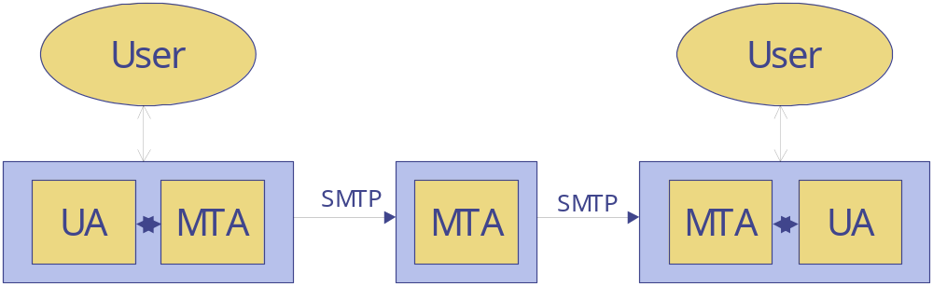
    many email systems exist; examples are Outlook, Eudora, Netscape, …
    email systems consist of two subsystems: User Agent (UA) and Message Transfer Agent (MTA)

Slide 22
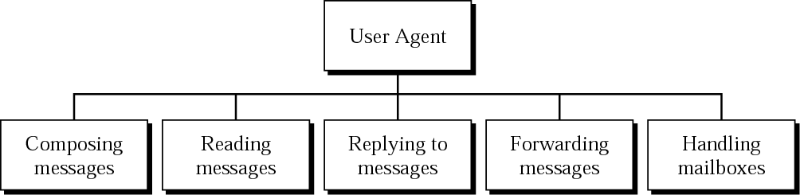
    i. User Agent
      a user agent is a software that
        composes messages (by providing a template on the screen, some have built-in editors with more functionalities - spell and grammar checking, etc., one can also use any other editor)
        reads incoming messages (checks incoming mails in the mailbox, shows an on-line summary of each received mail - sender, size, date, flag fields, ...)
        replies to messages (to the original sender or to all recipients)
        forwards messages (to a third party)
        handling mailboxes (inbox and outbox)
      a user agent can be command-driven or GUI-based

Slide 23
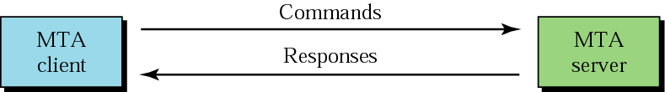
  ii. Message Transfer Agent
    relays messages from the sender to the receiver
    it is a daemon running in the background
    to send mail, a system must have a client MTA; and to receive mail, a system must have a server MTA
    in the Internet, message transfer is done through a protocol (and software) named SMTP (Simple Mail Transfer Protocol); there were other protocols but failed, e.g. the X.400 recommendation by CCITT
    SMTP uses port 25
    SMTP uses commands and responses to transfer messages between an MTA client and an MTA server

Slide 24
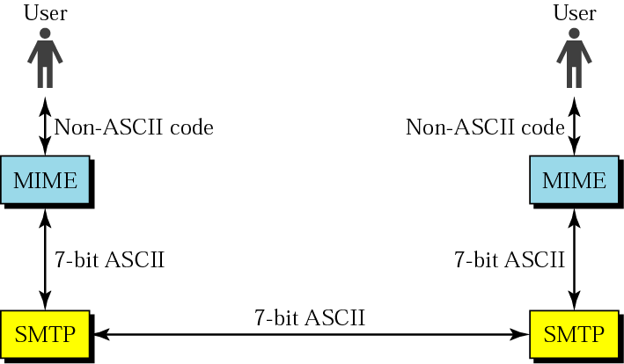
    originally, emails consisted of 7-bit ASCII text
    problems
      can not be used for languages that are not supported by 7-bit ASCII characters (French, German, Hebrew, ...)
      can not be used to send binary files, video or audio
    MIME - Multipurpose Internet Mail Extensions
      MIME is a supplemental protocol that allows non-ASCII data to be sent using the existing mail programs and protocols; only the sending and receiving programs need to be changed
      it transforms non-ASCII data at the sender site to ASCII and back to non-ASCII at the receiving site

Slide 25
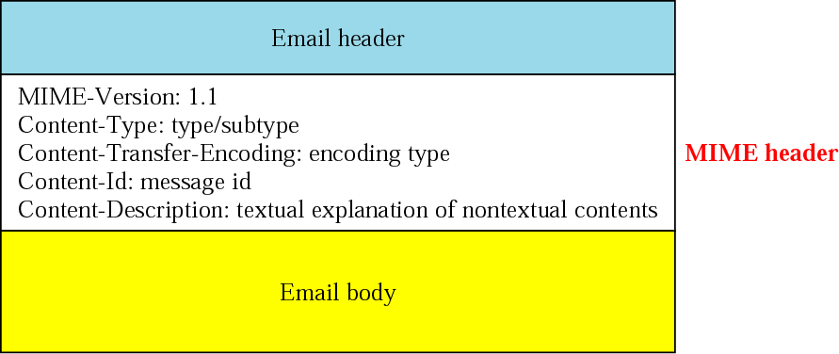
    MIME defines five headers that can be added to the original SMTP header to define the transformation parameters
    MIME-Version: the current version is 1.1
    Content-Id: uniquely identifies the whole message in a multiple-message environment
    Content-Description: defines whether the body is image, audio, or video
    Content-Type: the type of data used in the body of the message

Slide 26
    Data types and subtypes
Type | Subtype | Description
Text | Plain | Unformatted text; no transformation needed
Multipart | Mixed | Body contains ordered parts of different data types
 | Parallel | Same as above, but no order
 | Digest | Similar to mixed, but the default is message/RFC822
 | Alternative | Parts are different versions of the same message
Message | RFC822 | Body is an encapsulated message
 | Partial | Body is a fragment of a bigger message
 | Ext. Body | Body is a reference to another message
Image | JPEG | Image is in JPEG
 | GIF | Image is in GIF format
Video | MPEG | Video is in MPEG format
Audio | Basic | Audible sound
Application | PostScript | Adobe PostScript printable document
 | Octet-Stream | General binary data (8-bit bytes)

Slide 27
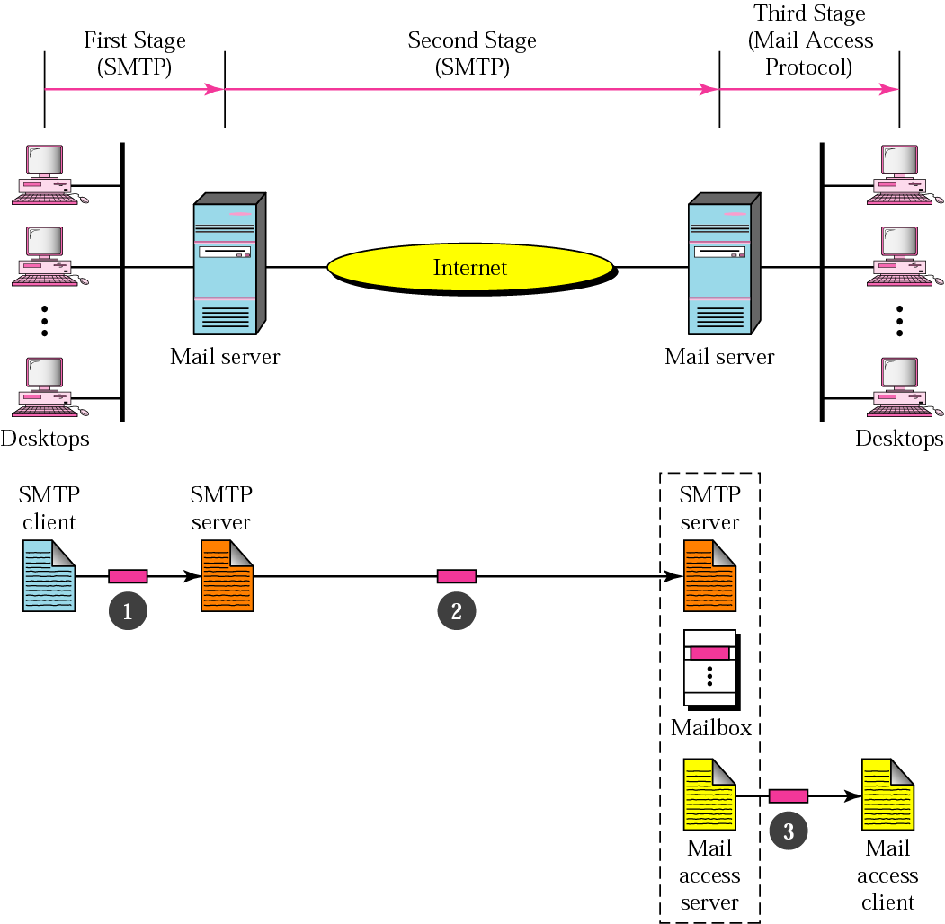
    Mail Delivery
      mail delivery consists of three stages

Slide 28
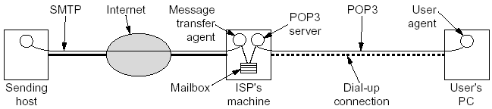
    Mail Access Protocols
      the first and second stages of mail delivery use SMTP
      SMTP is not involved in the third stage since SMTP is a push protocol; it pushes the message from the sender to the receiver
      the operation of SMTP starts with the sender, not the receiver
      but the third stage needs a pull protocol; the operation must start with the recipient; mail access protocols required
      there are two mail access protocols: POP3 and IMAP
      POP3 - Post Office Protocol, version 3
        the client POP3 software is installed on the recipient machine; the server POP3 software is installed on the mail server

Slide 29
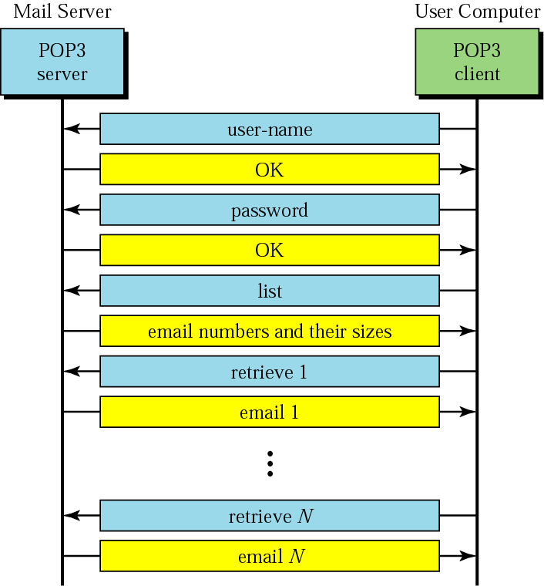
      after establishing a TCP connection at port 110, the POP3 protocol goes through three stages
        authorization: for the user to login
        transactions: reading emails, marking them for deletion, ...
        update: committing deletions

Slide 30
    IMAP - Internet Mail Access Protocol
      POP3 assumes that each time a client accesses the server, the whole mailbox will be cleared (transferred); not desirable if people access their mailboxes from different places such as a cybercafe
      IMAP is similar to POP3 but with the following additional features
        a user can check the email header prior to downloading
        a user can search the contents of the email for a specific string
        a user can partially download an email; like without attachments
        a user can create, delete, or rename mailboxes on the mail server (POP3 can do this only on the local machine)
        a user can create a hierarchy of mailboxes in a folder for email storage
      it uses port 143

Slide 31
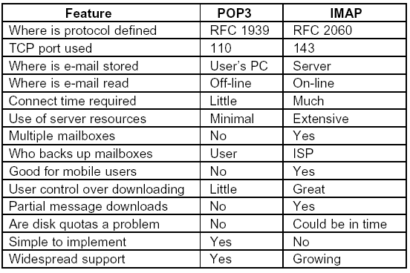
      comparison of POP3 and IMAP

Slide 32
    Web-Based Mail
      some websites provide email service to anyone
      examples are Yahoo and Gmail
      mail transfer from the user to the mail server and from the receiving server (the web server) to the user’s browser is through HTTP (instead of POP3 or IMAP)
      a TCP connection is still created using SMTP at port 25 before mail transfer begins
      authentication is done by filling a form
    other features provided by many systems independently of POP3 or IMAP
      spam filtering
      to temporarily forward an incoming mail to a different address
      a vacation daemon; Thanks I am on a vacation and will reply as soon as I am back.

Slide 33
    2. FTP - File Transfer Protocol
      a standard mechanism provided by the Internet for copying a file from one host to another
      some heterogeneity problems solved by FTP: two systems may
        use different file name conventions
        have different ways to represent text and data
        have different directory structures
      FTP establishes two connections between the client and the server (different from other client-server applications); one is used for data transfer, the other for control information (commands and responses)
      FTP uses the services of TCP; it needs two TCP connections; the well-known port 21 is used for the control connection, and the well-known port 20 is used for the data connection

Slide 34
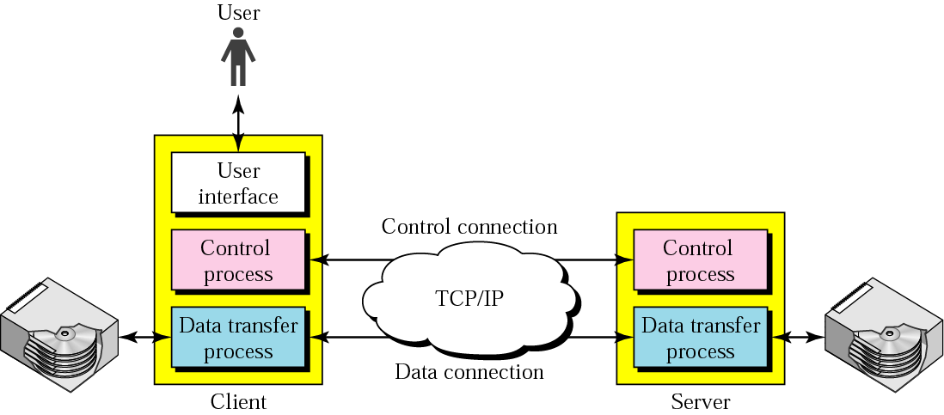
      the client has three components and the server has two
      the control connection is maintained during the entire interactive FTP session; the data connection is opened and then closed for each file transferred

Slide 35

      two different approaches of communication; one each for control connection and for data transfer
      Communication over Control Connection
        uses same approach as SMTP - the ASCII character set
        communication is achieved through commands and responses
        each command or response is one short line (no worry about file format or structure)

Slide 36
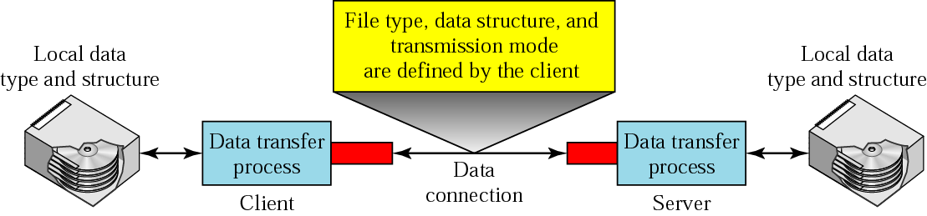
      Communication over Data Connection
        to solve the heterogeneity problem, the client must define the type of file to be transferred, the structure of the data, and the transmission mode

Slide 37
  File Type: FTP can transfer one of the following file types
    ASCII file: default format; the sender transforms from its own representation to ASCII and the receiver transforms from ASCII to its own representation
    EBCDIC file: if one or both ends of the connection use EBCDIC encoding, the file can be transferred using EBCDIC encoding
    Image file: the default format for transferring binary files; the file is sent as continuous streams of bits without any interpretation or encoding
  Data Structure: one of the following interpretations about the structure of the data can be used
    File Structure: default mode; the file has no structure; it is a continuous stream of bytes
    Record Structure: the file is divided into records (or structs in C); can be used only with text files
    Page Structure: the file is divided into pages, with each page having a page number and a page header; the pages can be stored or accessed randomly or sequentially

Slide 38
  Transmission Mode: it can use one of the following transmission modes
    Stream mode: default mode; data are delivered from FTP to TCP as a continuous stream of bytes; TCP is responsible for chopping data into segments of appropriate size
    Block Mode: each block is preceded by a 3-byte header; the first byte is called the block descriptor; the next 2 bytes define the size of the block in bytes
    Compressed Mode: if the file is big, the data can be compressed normally using run-length encoding where consecutive appearances of a data unit are replaced by one occurrence and the number of repetitions
  User Interface
    most operating systems provide a user interface to access the services of FTP
    the interface prompts the user for the appropriate input; then it is changed to the corresponding FTP command

Slide 39
    e.g. the user input is shown in blue; some of the commands are provided automatically by the interface; the user receives a prompt and provides only the arguments
        $ ftp networking.cs.aau.edu.et
        Connected to networking.cs.aau.edu.et
        220 Server ready
        Name: mulugeta
        Password: *******
        ftp > ls /usr/user/report
        200 OK
        150 Opening ASCII mode
        ...........
        ...........
        226 transfer complete
        ftp > close
        221 Goodbye
        ftp > quit

Slide 40
  Anonymous FTP
    to use FTP, a user needs a user name and a password on the remote server
    some sites have a set of files accessible for the public without the need to have a user name and a password
    the user can use anonymous as a user name and guest as a password

Slide 41
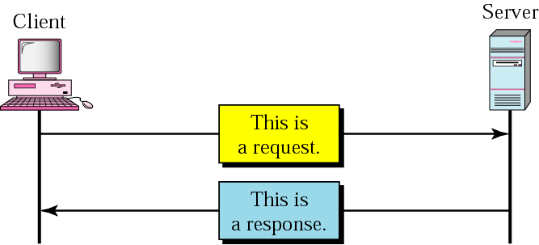
  3. HTTP - Hypertext Transfer Protocol
    a file transfer protocol specifically designed to facilitate access to the WWW
    it transfers data in the form of plain text, hypertext, audio, video, ...
    designed for an environment where there are rapid jumps from one document to another
    similar to FTP (but only one TCP connection on well-known port 80) and SMTP (but differs on how messages are sent from the client to the server and from the server to the client)
    two kinds of messages: request and response

Slide 42
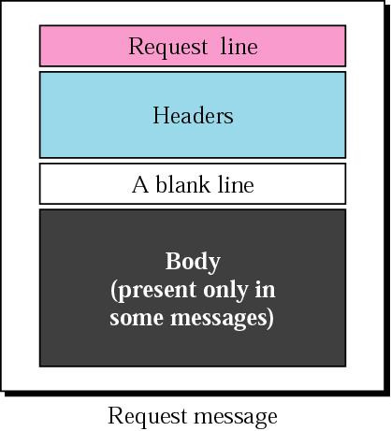
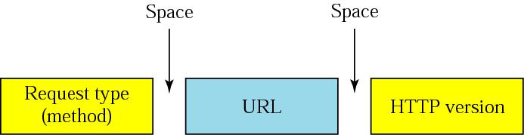
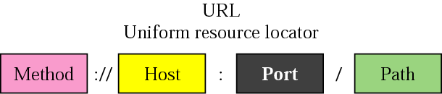
  Request Messages
    consists of a request line, headers, and sometimes a body
    the request line defines the request type, resource (URL), and HTTP version (currently 1.1)
    URL: a standard for specifying any kind of information on the Internet; it defines 4 things:
e.g., http://www.aaustudents.com/hobbies.html

Slide 43
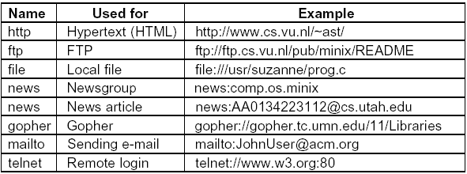
        method: the protocol used to retrieve a document (ftp, http, ...)
        host computer: the computer where the information is located; usually an alias name that begins with the characters www
        port (optional): the port number of the server
        path: of the file where the information is located

Slide 44
    request type or method: defines several kinds of messages; commands or requests a client issues to the server
      GET: to retrieve a document
      HEAD: when a client wants some information about the document (its header) but not the document itself
      POST: to provide some input to the server - appending a new data such as posting a message to a newsgroup or adding a file to a bulletin board
      PUT: to provide a new or replacement document to the server
      - authentication required
      PATCH: similar to PUT but the request contains a list of differences that should be implemented in the existing file
      MOVE: to move a file to another location
      DELETE: removes a page from a server - authentication required
      LINK: create a link or links from a document to another location
      UNLINK delete a link
      OPTION: to ask a server about available options

Slide 45
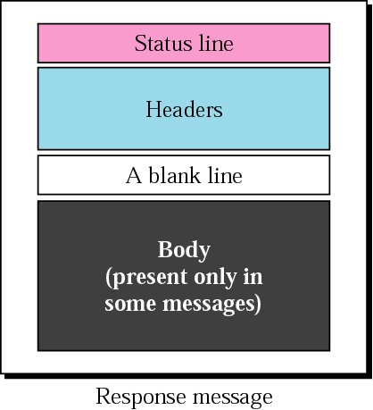
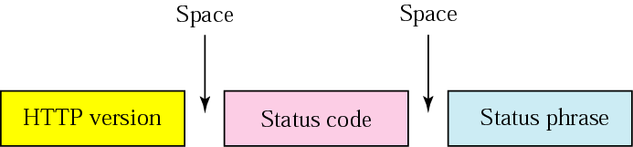
  Response Message
    consists of a status line, headers, and sometimes a body
      status line
        HTTP version: same as above
        Status code: a three digit number specifying the status of a command; the first digit is used to divide the responses into 5 major groups
        Status phrase: status code in text form

Slide 46
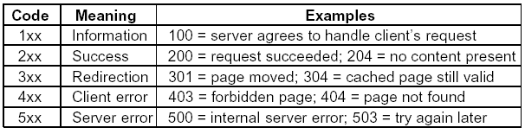
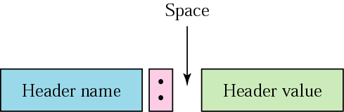
  Headers (for both types of messages)
    to exchange additional information
    e.g., the client can request a document to be sent in a special format
    each header line consists of a header name, and a header value

Slide 47
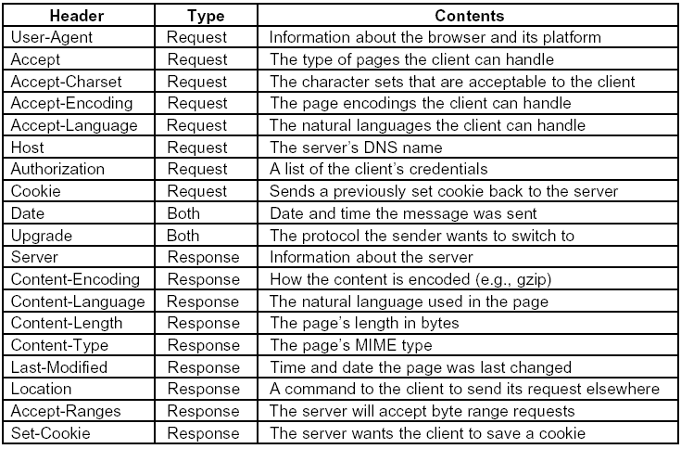

Slide 48
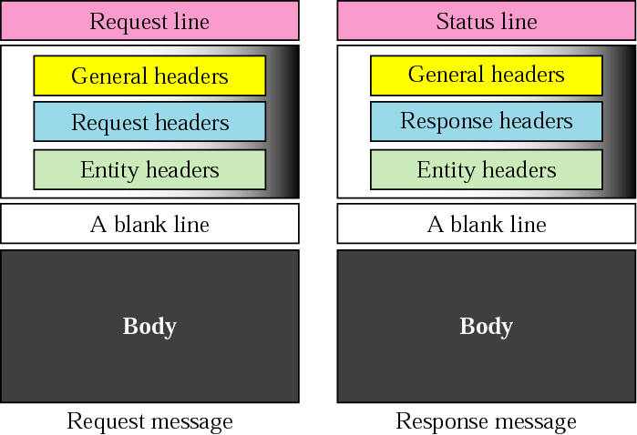
  a header line belongs to one of 4 categories: general header, request header, response header, and entity header
    General Header: gives general information about the message
    Request Header: specifies the client’s configuration and preferred document format
    Response Header: specifies the server’s configuration and special information about the request
    Entity Header: information about the body of the document

Slide 49
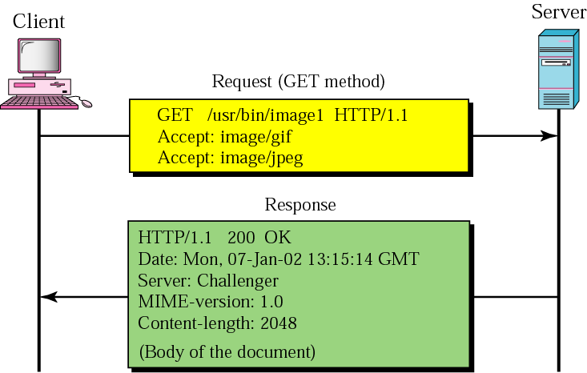
  example 1
    request message
      to retrieve an image using the GET command with the path /usr/bin/image1
      the request line shows the method, the URL, and the HTTP version
      two header lines: the client specifying that it can accept images in GIF and JPEG formats
      has no body
    response message
      contains the status line and four lines of header
      the header lines define the date, server, MIME version, and length of the document
      the body of the document follows the header

Slide 50
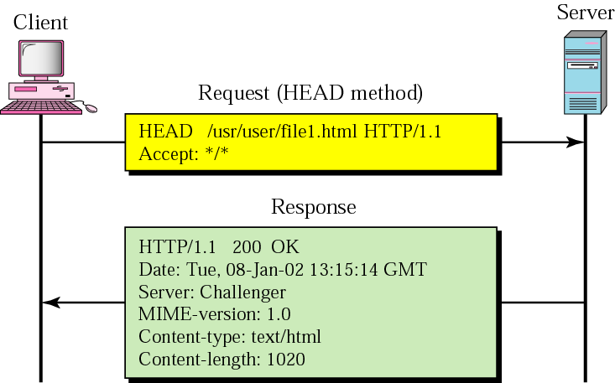
  example 2
    request message
      to retrieve information about an HTML document using the HEAD command
      the request line shows the method, URL, and HTTP version
      the header is one line showing that the client can accept the document in any format (wild card)
      has no body
    response message
      contains the status line and five lines of header
      the header lines define the date, server, MIME version, type of document, and length of the document
      has no body

Slide 51
  Proxy Server
    HTTP supports proxy servers
    a computer that keeps copies of responses to recent requests
    the HTTP client sends a request to the proxy server
    the proxy server checks its cache; if the response is not stored in the cache, it sends the request to the corresponding server
    the proxy server reduces the load on the original server, decreases traffic, and improves latency

Slide 52
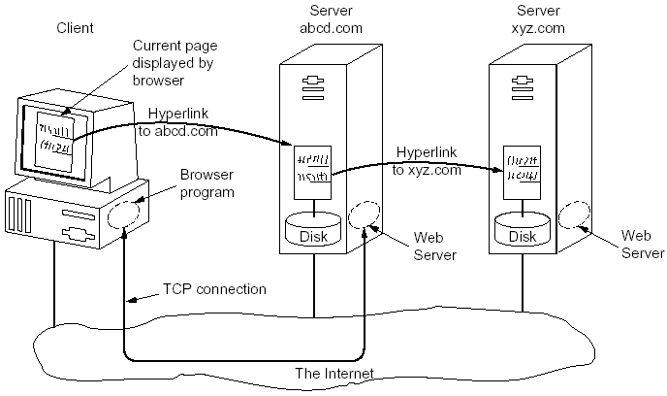
  4. WWW
    a repository of information spread all over the world and linked together; strings of text within a page that link to other documents are called hyperlinks
    it was initiated by CERN to create a system to handle distributed resources for scientific research (initial proposal by Tim Berners-Lee); W3C was formed in 1994 to further develop the Web (standardizing protocols and encouraging interoperability between sites) see www.w3.org
    WWW is a client-server service distributed over many locations called websites

Slide 53
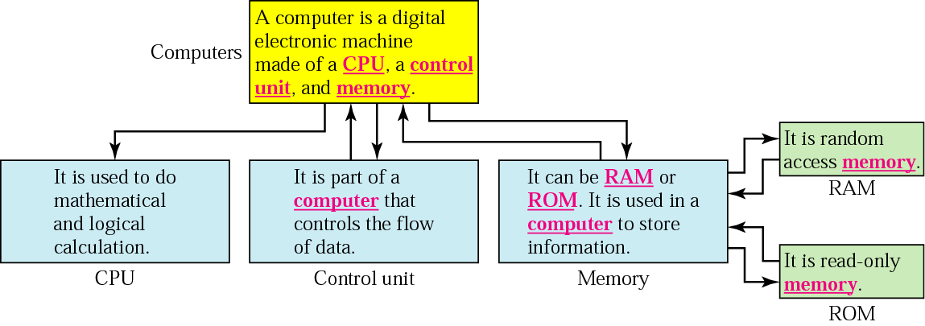
    Hypertext and Hypermedia
      hypertext: information is stored in a set of documents that are linked using the concept of pointers; such documents contain only text
      hypermedia: documents can contain pictures, graphics, and sound
      a unit of hypertext or hypermedia available on the Web is called a page; the main page for an organization or an individual is known as a homepage; a page is viewed with a program called a browser

Slide 54
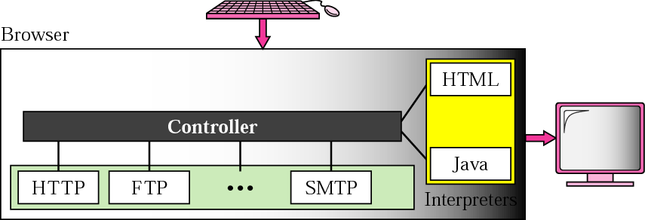
    Brower Architecture
      a lot of them exist, but all use nearly the same architecture
      each consists of three parts: a controller, client programs, and interpreters
      the controller receives input from the user and uses the client programs to access the document; after accessing the document, the controller uses one of the interpreters to display the document on the screen; the client programs can be one of the protocols such as HTTP, FTP, or SMTP; the interpreter can be HTML or Java (when Applets are used)

Slide 55
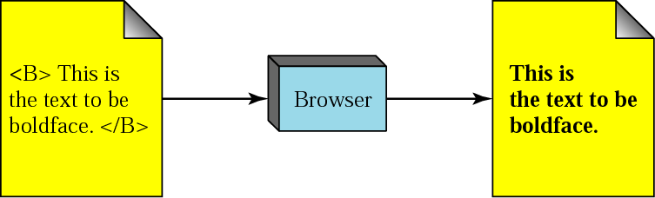
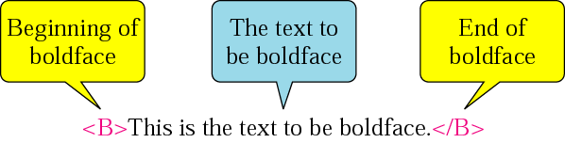
    Web documents can be grouped into 3 broad categories: static, dynamic, and active
    Static Documents
      fixed-content documents created and stored in a server
      the contents of the file are determined when the file is created, not when it is used; can be changed, but not by the user
    HTML - Hypertext Markup Language
      a language for creating Web pages (that include text, graphics, and pointers to other Web pages)
      a markup language allows to embed formatting instructions in the file itself and stored with the text (other markup languages: TeX and troff)
      HTML lets us use only ASCII characters for both the main text and formatting instructions (unlike WYSIWYG word processing programs); the later ones are called tags (enclosed in < and > and usually come in pairs)
      other mark up languages: XML (eXtensible Markup Language), XSL (eXtensible Style Language), XHTML (eXtended HTML)

Slide 56
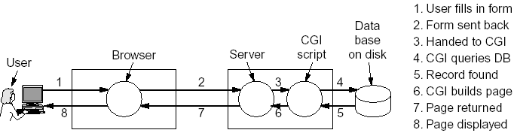
    Dynamic Documents
      do not exist in a predefined format; instead a dynamic document is created by a Web server whenever a browser requests the document, for example, by filling a form
      the server runs an application program (or a script); the output of the program is sent to the user
    CGI - Common Gateway Interface
      a technology that creates and handles dynamic documents
      it is a set of standards that defines how a dynamic document should be written, how input data should be supplied to the program, and how the output result should be used
      it is not a new language; instead it allows programmers to use any of several languages such as C, C++, Borne or C Shell, Perl, ... by defining a set of rules and terms that the programmer should follow

Slide 57
    a link for a dynamic document has the form: www.abc.com/cgi-bin/abc.perl
    other scripting languages include the following
      PHP - Hypertext Processor
        to embed little scripts inside HTML pages
        www.abc.com/abc.php
      JSP - JavaServer Pages
        similar to PHP but the dynamic part is written in Java
        www.abc.com/abc.jsp
      ASP - Active Server Pages
        Microsoft’s version of PHP and JSP
        it uses Visual Basic Script - Microsoft’s proprietary scripting language - for the dynamic part
        www.abc.com/abc.asp

Slide 58
      JavaScript
        a full-blown high-level programming language
        used when the interaction is with the user at the client computer for designing interactive Web pages (e.g., to track mouse motion - so that something happens when the mouse is moved over some image or text; the image changes or a menu appears)
  Active Documents
    for many applications, we need a program to be run at the client site; for example, to create animated graphics on the screen
    these are called active documents

Slide 59
    an active document is sent by a server in the form of byte code; the document is then run at the client (browser) site
      Applets
        small Java programs that have been compiled into machine instructions for a virtual computer - JVM - Java Virtual Machine
        since they are interpreted, the Java interpreter can prevent them from doing illegal things (at least in theory)
      ActiveX controls
        Microsoft’s version for Sun’s Java applets
        they are programs compiled to Pentium machine language and executed by the bare hardware
        they are downloaded and executed by the browser (IE) - security issue
  Read about the wireless Web - for small portable devices
    WAP - The Wireless Application Protocol
    i-Mode - information mode

Slide 60
  5. Multimedia
    two or more media (is a book multimedia?)
    the combination of text, graphics, images, video and audio used together; at least one must be continuous (time-dependent like audio, video, animation)
    sometimes pure audio (or video) is referred to as multimedia
    Multimedia System
      the integrated production, processing, storage, representation, and transmission of several time-dependent and time-independent media streams
    Audio (sound) wave
      an audio (sound) wave is a one-dimensional acoustic (pressure) wave
      causes vibration in the eardrum or in a microphone
      frequency range of human ear: 20 –20,000 Hz (20 KHz)
      audio waves can be converted to digital form by an ADC - Analog Digital Converter

Slide 61
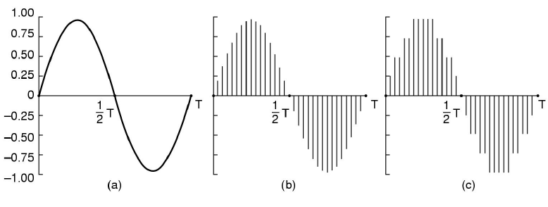
  Analog Digital Conversion (ADC)
    Sampling: of the audio wave in every ∆T secs
    Quantization
      precision of the digital sample depends on the number of bits
      quantization noise: error due to finite number of bits/sample
    audio encoding - example
    a) a sine wave b) sampling the sine wave c) quantizing the samples to 4 bits

Slide 62
    audio encoding - standards
      telephone
        8,000 samples/sec (up to 4 KHz)
        Needs 64 Kbps (Pulse Code Modulation - PCM, 8-bit samples in Europe), or 56 Kbps (USA, Japan – 7 bits)
      audio CDs
        44,100 samples/sec (up to 20 KHz)
        16-bit samples: quantization error is small but audible
        needs 705.6 Kbps (44100x16) for mono, 1.411 Mbps for stereo
      MP3 (MPEG-1 audio layer 3) compression
        based on psycho acoustic models (128 Kbps)

Slide 63
  Analog Video - Basics
    sequence of images flashing faster than 50/sec
    makes the impression of a continuous movie
    TV (black-and-white)
      an electron beam scans the image rapidly
      from left to right and from top to bottom
      at the end of the scan (a frame) the scan retraces
      NTSC scans 525 lines (483 effective), 30 frames/sec
      PAL and SECAM: 625 lines (576), 25 frames/sec
      in both, the top few and the bottom few lines are not displayed - to approximate a rectangular image on the original round CRTs
      25 frames/s produce smooth motion, but flicker
      Interlacing solves this; 50 half frames (fields) / sec
      Non interlaced: progressive scanning

Slide 64
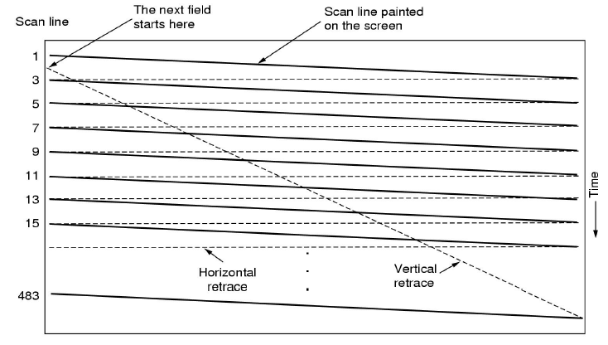

Slide 65
  Analog Video – color
    3 beams moving in unison for the 3 additive primary colors – Red, Green, Blue (RGB)
  Digital Video
      a digital video is a sequence of frames (25 or 30 frames per second), each consisting of a rectangular grid of picture elements, or pixels
      each pixel can be
        1 bit - black and white
        8 bits - to represent 256 gray labels (high-quality black and white video)
        24 bits for color - 16 million colors (more than enough); 8 bits each for R, G, and B

Slide 66
      Smoothness vs. flickering
        Smoothness: number of different images per second (> 25/s)
        Flicker: number of refresh of the display per second (> 70/s)
        good computer monitors rescan with > 70Hz
        the image is repainted from RAM – no interlace
      Common configurations (4:3 aspect ratio)
        VGA (640*480), SVGA (800*600), XGA (1024*768)
        XGA needs 472 Mbps (at 25 frame/s) - 1024*768*24*25; this requires a high-data rate technology such as SONET

Slide 67
    Compression
      storing or transmitting uncompressed video/audio requires huge resources (disk space and bandwidth)
      compression is required to send data over the Internet
      many compression algorithms designed for both audio and video
      two algorithms required: encoding by the source and decoding by the destination (details out of scope)

Slide 68
  Audio and video Services
    three major services: streaming stored audio/video, streaming live audio/video, and real-time interactive audio/video
    i. Streaming stored audio/video
      streaming means a user can listen (or watch) the file after the downloading has started
      the files are compressed and stored on a server
      examples are songs, famous lectures, movies, TV shows, music video clips, ...
      such a service is usually called on-demand audio/video (VoD) - similar to a rental store
      communication is often unicast and on-demand
      there are different approaches

Slide 69
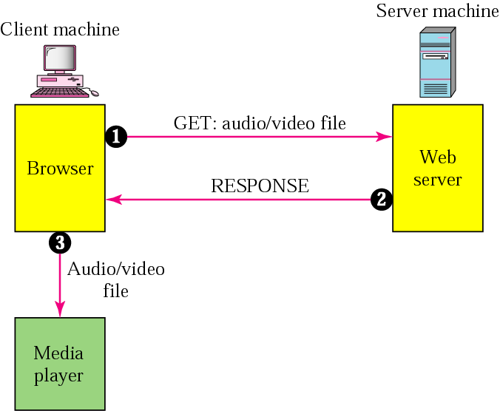
  a. Using a Web Server
    download a compressed audio/video file as text file
    the client can use the services of HTTP and then use a media player to play the file
    simple and does not involve streaming
    drawbacks
      downloading takes time; delay latency
      downloading may not be acceptable by the owners; hence usually stored on a scratch file
1. Establish TCP connection,
  Send HTTP GET request
  2. Server gets file from disk,
  File sent back
  3. Browser writes file to disk,
  Media player fetches file block by block and plays it

Slide 70
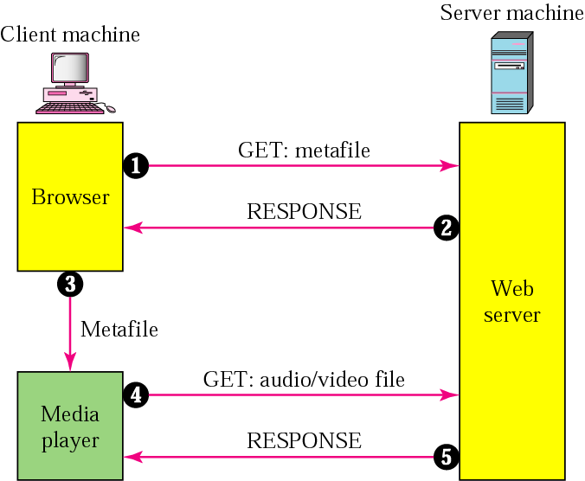
  b. Using a Web Server with Metafile
    the media player is directly connected to the Web server
    the Web server stores two files: the actual audio/video file and a metafile that holds information about the audio/video file
    the media player gets the URL of the audio/video file from the metafile to contact the Web server
    drawbacks
      both the browser and the media player use the services of HTTP designed to run over TCP; this is ok for getting the metafile, but not for getting the audio/video file
      TCP retransmits a lost or damaged segment; not acceptable in streaming; we need to use UDP
1. Establish TCP connection,
  Send HTTP GET request
  2. Web server sends metafile
  3. Metafile passed to media player
  4. Media player uses URL to access the Web server
  5. Web server responds

Slide 71
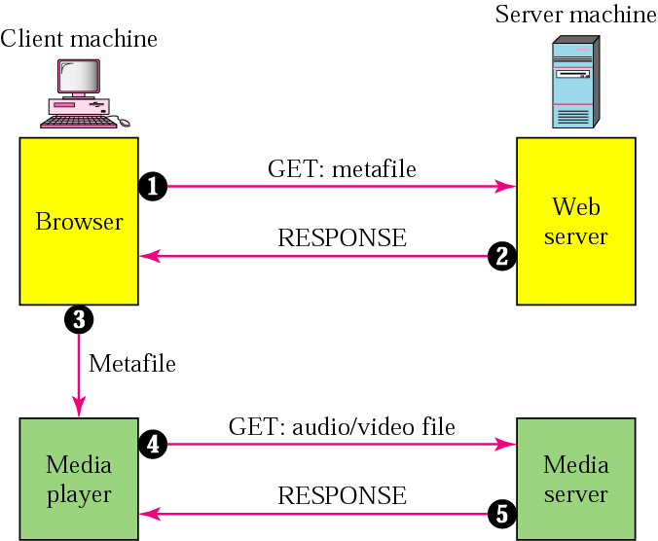
  c. Using a Media Server
    since HTTP which accesses the Web server and the Web server itself are designed for TCP, we need another server, a media server
    in this approach, only the media player accesses the media server and can use any protocol
1. Establish TCP connection,
  Send HTTP GET request
  2. Web server sends metafile
  3. Metafile passed to media player
  4. Media player uses URL to access the Media server; downloading can take place by any protocol that uses UDP
  5. Media server responds

Slide 72
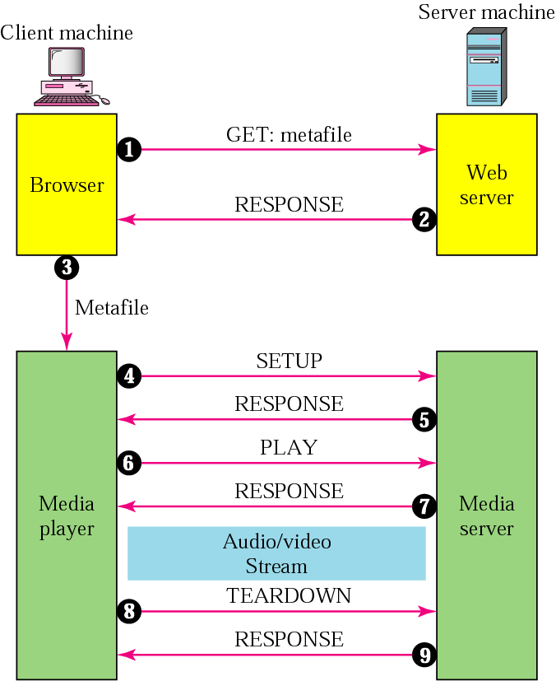
  d. Using a Media Server and RTSP
    RTSP - Real-Time Streaming Protocol - is designed to add some functionalities to the streaming process
    the media player can send other messages: PAUSE, PLAY, ...
1. Establish TCP connection,
  Send HTTP GET request
  2. Web server sends metafile
  3. Metafile passed to media player
  4. Media player sends a SETUP message to create connection with the media server
  5. Media server responds
  6. Media player sends a PLAY message to start playing
  7. File is downloaded using a protocol that runs over UDP
  8. Connection is broken using the TEARDOWN message
  9. Media server responds

Slide 73
  ii. Streaming live audio/video
    the broadcasting of radio and TV (not popular yet) programs through the Internet
    communication is multicast and live
    live streaming is better suited to the multicast services of IP and the use of protocols such as UDP and RTP
    currently, live streaming uses TCP and multiple unicasting instead of multicasting
  iii. Real-time interactive audio/video
    the use of the Internet for people to interactively communicate with one another
    examples are Internet telephony or voice over IP and Internet videoconferencing; two way communication required

Slide 74
    Characteristics of Real-Time Data
      Time Relationship
        real-time data require the preservation of the time relationship between packets
        when there is delay between packets, jitter is introduced
      Timestamp
        to inform the receiver when each packet is to be played
        by separating the arrival time from the playback time, jitter can be prevented
      Playback Buffer
        to store data until they are played back
      Ordering
        a sequence number for each packet is required
        a timestamp alone can not inform the receiver if a packet is lost
        example: suppose the timestamps are 0, 10, and 20; if the second packet is lost, the receiver does not know only with timestamps

Slide 75
    Multicasting
      for audio and video conferencing and similar applications
    Mixing
      mixing means combining several streams of traffic into one traffic
      if there is more than one source sending data at the same time
    Support from Transport Layer Protocol
      TCP is not suitable for interactive multimedia traffic because we can not allow retransmission of packets
      UDP is more suitable for interactive multimedia traffic; it supports multicasting and has no retransmission strategy; however, UDP has no provision for timestamping, sequencing, or mixing
      UDP is used in conjunction with a new transport protocol - RTP

Slide 76
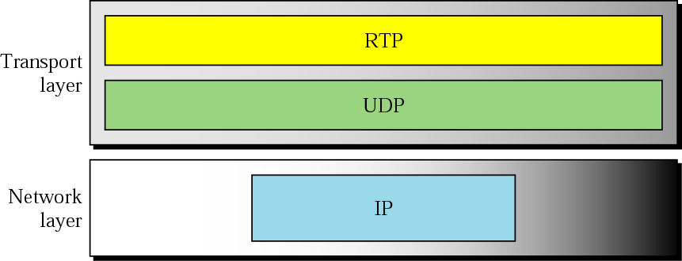
  RTP - Real-Time Transport Protocol
    the protocol designed to handle real-time traffic on the Internet
    it is used in conjunction with UDP since RTP has no delivery mechanisms (multicasting, port numbers, ...)
    it stands between UDP and the application program
    its major contributions are timestamping, sequencing, and mixing facilities

Slide 77
    RTP allows only messages that hold data
    we need other control messages to control the flow and quality of data and allow the recipient to send feedback to the source
    the RTCP - Real-Time Transport Control Protocol - was designed for this purpose
  Some application examples
    Internet Radio
      it is gaining popularity nowadays
      two approaches
        1. programs are prerecorded and stored on disk; listeners can connect to the radio station’s archives; similar to streaming stored audio/video; it is also possible to store each program just after it is broadcast live and running some minutes or hours later; e.g., BBC
        2. live broadcast over the Internet, may be simultaneously with air transmission; same as streaming live audio/video

Slide 78
    Voice over IP (Internet Telephony)
      idea: use the Internet as a telephone network
      instead of communicating over a circuit-switched network, it allows communication between two parties over the packet-switched Internet
      two protocols have been designed to handle this type of communication: SIP and H.323
      H.323
        a standard by ITU to allow telephones on the public telephone network to talk to computers connected to the Internet

Slide 79
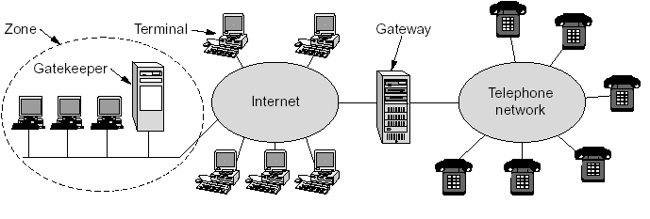
      H.323 architecture
      Gateway: connects the Internet to the telephone network; it transforms a telephone network message to an Internet message
      communicating devices are called terminals
      Gatekeeper: registers users on a LAN and knows the IP addresses under its jurisdiction, called a zone
      H.323 is more of an architectural overview of Internet telephony rather than a specific protocol; it references (uses) a large number of specific protocols to establish and maintain communication (for speech coding, call setup, signaling, data transport, ...)

Slide 80

    G.711 (it is PCM - for audio encoding) or G.723.1: for compression
    H.245: allows the parties to negotiate the compression method; since multiple compression algorithms are required; also used to negotiate other aspects such as the bit rate
    Q.931: to establish and terminate connections (providing dial tones, making ringing sounds, ...)
    H.225 (also called RAS - Registration/Administration/Status): for registration with the gatekeeper; to join and leave the zone; bandwidth allocation for QoS
    RTP: for actual data transmission
    RTCP: for the control of the RTP channels

Slide 81
    SIP - Session Initiation Protocol
      H.323 is large, complex, and inflexible (may be because it was not designed by the Internet community!)
      IETF came up with SIP, an application layer protocol that establishes, manages, and terminates a multimedia session
      can be used to create two-party, multiparty (everyone can hear and speak), or multicast sessions (one sender, many receivers)
      it describes how to setup Internet telephone calls, video conferences, and other multimedia connections
      it handles only setup, management, and termination of sessions; other protocols, such as RTP/RTCP, are used for data transport
      can run on either UDP or TCP
      a text-based protocol like HTTP

Slide 82
      uses messages: six types defined, each with a header and a body
        INVITE: to initialize a session by the caller
        ACK: confirmation by the caller to the callee after the latter answers
        BYE: terminates the session
        OPTIONS: to query a machine about its capabilities
        CANCEL: to cancel an already started initialization process
        REGISTER: to make a connection when the callee is not available; to track down the callee

Slide 83


      Addresses: an email address, an IP address, a telephone number, and other types of addresses can be used to identify the sender and receiver; but must be in SIP format (also called scheme)
      A SIP session using SIP consists of three modules: establishing (a three-way handshake), communicating, and terminating

Slide 84

      Tracking a callee

Slide 85
That is all I have
Thank you very much for attending and
Good Luck

